Slide 1
Data storage
HDD vs SSD: differences and comparison
Student: Andronov Denis Andreevich 241-3210
2026

Slide 2
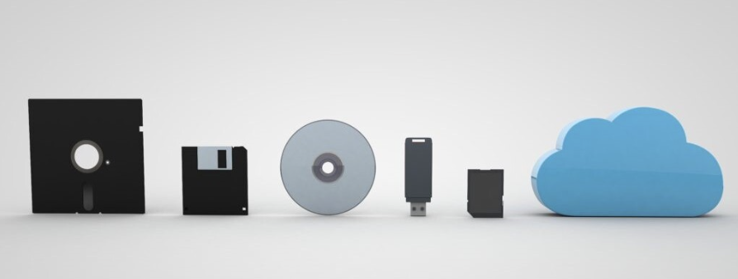
What is Data Storage?
Data storage is a technology used to record and keep digital information.
Used in computers, servers, mobile devices
Stores files, applications, and system data
Can be temporary or permanent

Slide 3
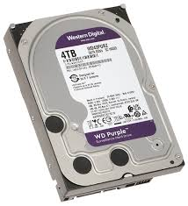
What is HDD?
HDD (Hard Disk Drive)
Mechanical storage device
Uses spinning magnetic disks
Data is read/write using a moving head
Cheaper and larger capacity

Slide 4
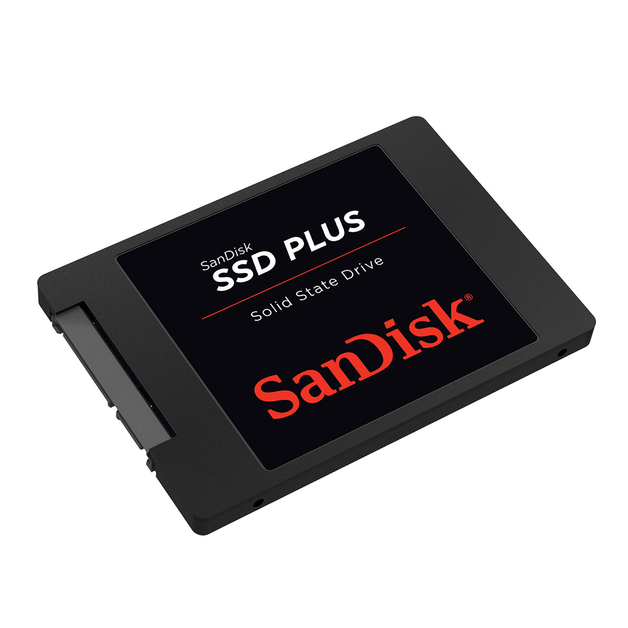
What is SSD?
SSD (Solid State Drive)
Uses flash memory
No moving parts
Very fast data access
More durable
⚠️ Disadvantages:
More expensive
Limited write cycles (but still long lifespan)

Slide 5
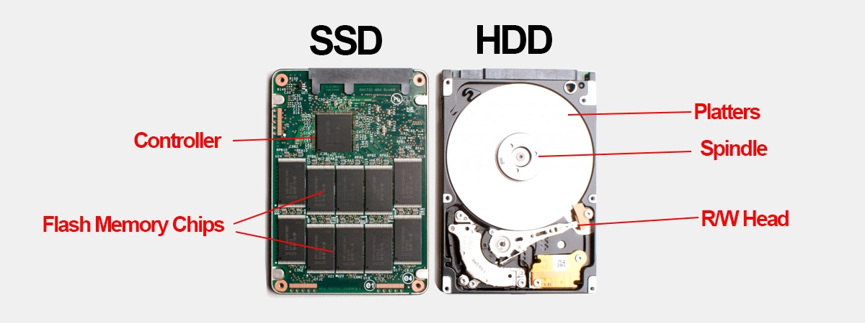
HDD vs SSD Comparison
Feature | HDD | SSD
Speed | Slow | Very fast
Durability | Low | High
Price | Cheap | Expensive
Noise | Noisy | Silent
Power usage | Higher | Lower
HDD: ~100–150 MB/s SSD: ~500 MB/s to 7000 MB/s (NVMe)

Slide 6
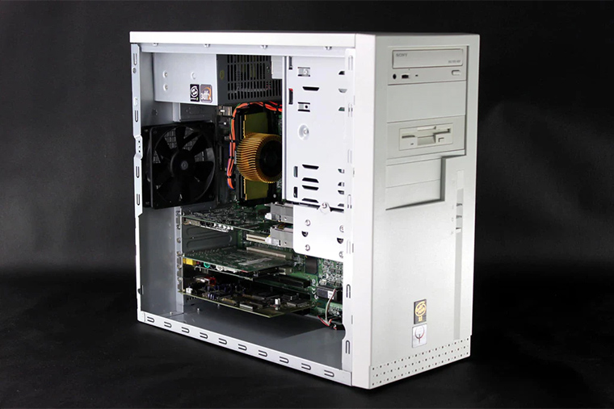

Where are they used?
HDD is used in:
Data backups
Servers with large storage needs
Budget PCs
SSD is used in:
Modern laptops
Gaming PCs
Operating systems

Slide 7
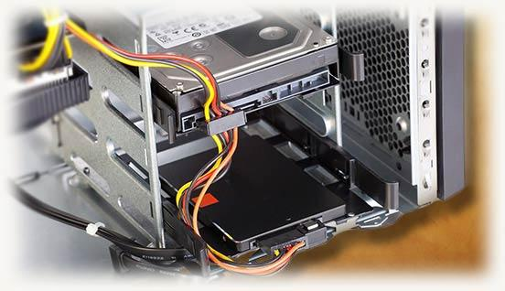
Where are they used?
HDD is used in:
Data backups
Servers with large storage needs
Budget PCs
SSD is used in:
Modern laptops
Gaming PCs
Operating systems
Some systems use both HDD + SSD SSD for OS and apps HDD for files and backups

Slide 8
Conclusion
HDD = cheap, large storage, slower
SSD = fast, durable, more expensive
SSD is the future of personal computing

Slide 9

Thanks for you attention

